Slide 1
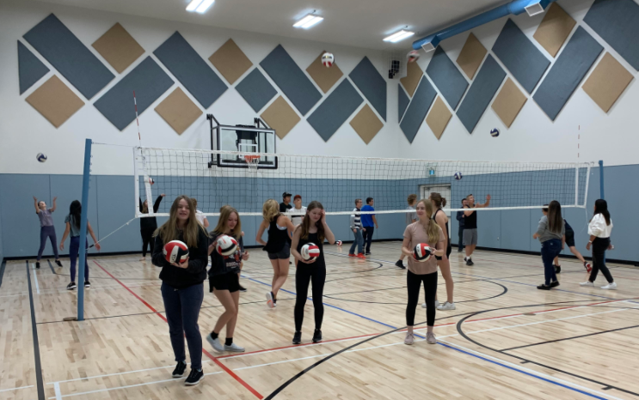
Taber Christian
High School Athletics
Phone: (403) 359-3835
Website:tchs.horizon.ab.ca

Slide 2
Who are we?
“The logo portrays that we are a strong and courageous community of Christ. The colour gold represents glory, foundation, Christ’s divinity and courage. The colour black represents revelation. The lion represents that we have the Lord living within us. The shield draws our connection to Taber Christian School, the Guardians”.
~ Jennifer Giesbrecht and Sara Froesse

Slide 3
Statement of Philosophy:
The athletic program at Taber Christian High School provides athletes, coaches, parents, and volunteers the opportunity to develop their unique God-given talents and abilities. In participating in inter-school athletics under the Alberta School’s Athletic Association, our athletes, coaches, and volunteers are committing to positively represent our school and community.
In doing so, we are committed to developing people of character, integrity, and responsibility who use their gifts and abilities to serve God, others, and themselves. It is our desire that through our athletics program, students, parents, community members will see God’s magnificent handiwork, and that we will demonstrate the profound love that we have for God and others. We are not ashamed of who we are in Christ (Romans 1:16), and it is our desire that we will boldly live out our faith within and outside of athletic competition.
Interschool athletics are created for the purpose of enjoyment and are designed to be fun for all involved. It is our deep hope that through our athletics program, that we will experience and demonstrate the inexpressible and glorious joy that we have in Christ (1 Peter 1: 8-9), positively reflecting our magnificent, mighty, and glorious Redeemer.

Slide 4
“Be more concerned with your character than your reputation, because your character is what you really are, while your reputation is merely what others think you are”
~ John Wooden
“Integrity is doing the right thing, even when no one is watching”
~ C.S. Lewis
“You cannot escape the responsibility of tomorrow, by evading it today”
~ Abraham Lincoln

Slide 5
Our Core Values
LIONS
ARE
BOLD

Slide 7
B Brave in the face of adversity
“The wicked flee though no one pursues, but the righteous are as bold as a lion.”
~ Proverbs 28:1

Slide 8
O Obedient to God’s call
“Each of you should use whatever gift you have received to serve others, as faithful stewards of God’s grace in its various forms. If anyone speaks, they should do so as one who speaks the very words of God. If anyone serves, they should do so with the strength God provides, so that in all things God may be praised through Jesus Christ.”
~ 1 Peter 4:10-11

Slide 9
L Love others unconditionally
“Love is patient, love is kind. It does not envy, it does not boast, it is not proud. It does not dishonor others, it is not self-seeking, it is not easily angered, it keeps no record of wrongs. Love does not delight in evil but rejoices with the truth. It always protects, always trusts, always hopes, always perseveres.”
~ 1 Corinthians 13:4-8

Slide 10
D Devoted to one another
“Be devoted to one another in love. Honor one another above yourselves. Never be lacking in zeal, but keep your spiritual fervor, serving the Lord. Be joyful in hope, patient in affliction, faithful in prayer.”
~ Romans 12:10-12

Slide 12
Athletic Program Offerings (In a typical year)
1. X-Country: Available for students in grades 10-12 September-October
2. Golf: Available for students in grades 10-12 September
3. Volleyball: September- November
a. Junior Varsity- Available for students in grades 10 and 11
b. Senior Varsity- Available for students in grades 10-12
4. Basketball: November-March
a. Junior Varsity- Available for students in grades 10 and 11
b. Senior Varsity- Available for students in grades 10-12
5. Curling: Available for students in grades 10-12 December-February
6. Badminton: Available for students in grades 10-12 March-May
7. Track and Field: Available for students in grades 10-12 April-June
*Athletic Program Offerings are subject to change based on student numbers and coaching availability

Slide 13
Golf
This year Golf Zones occurred on September 14. There will be more opportunities for students to participate and practice in the Spring!
The TCHS Golf Tournament: Our school golf tournament was a success! The school raised approx $25,000
Golf Coach: Jay Visser

Slide 14
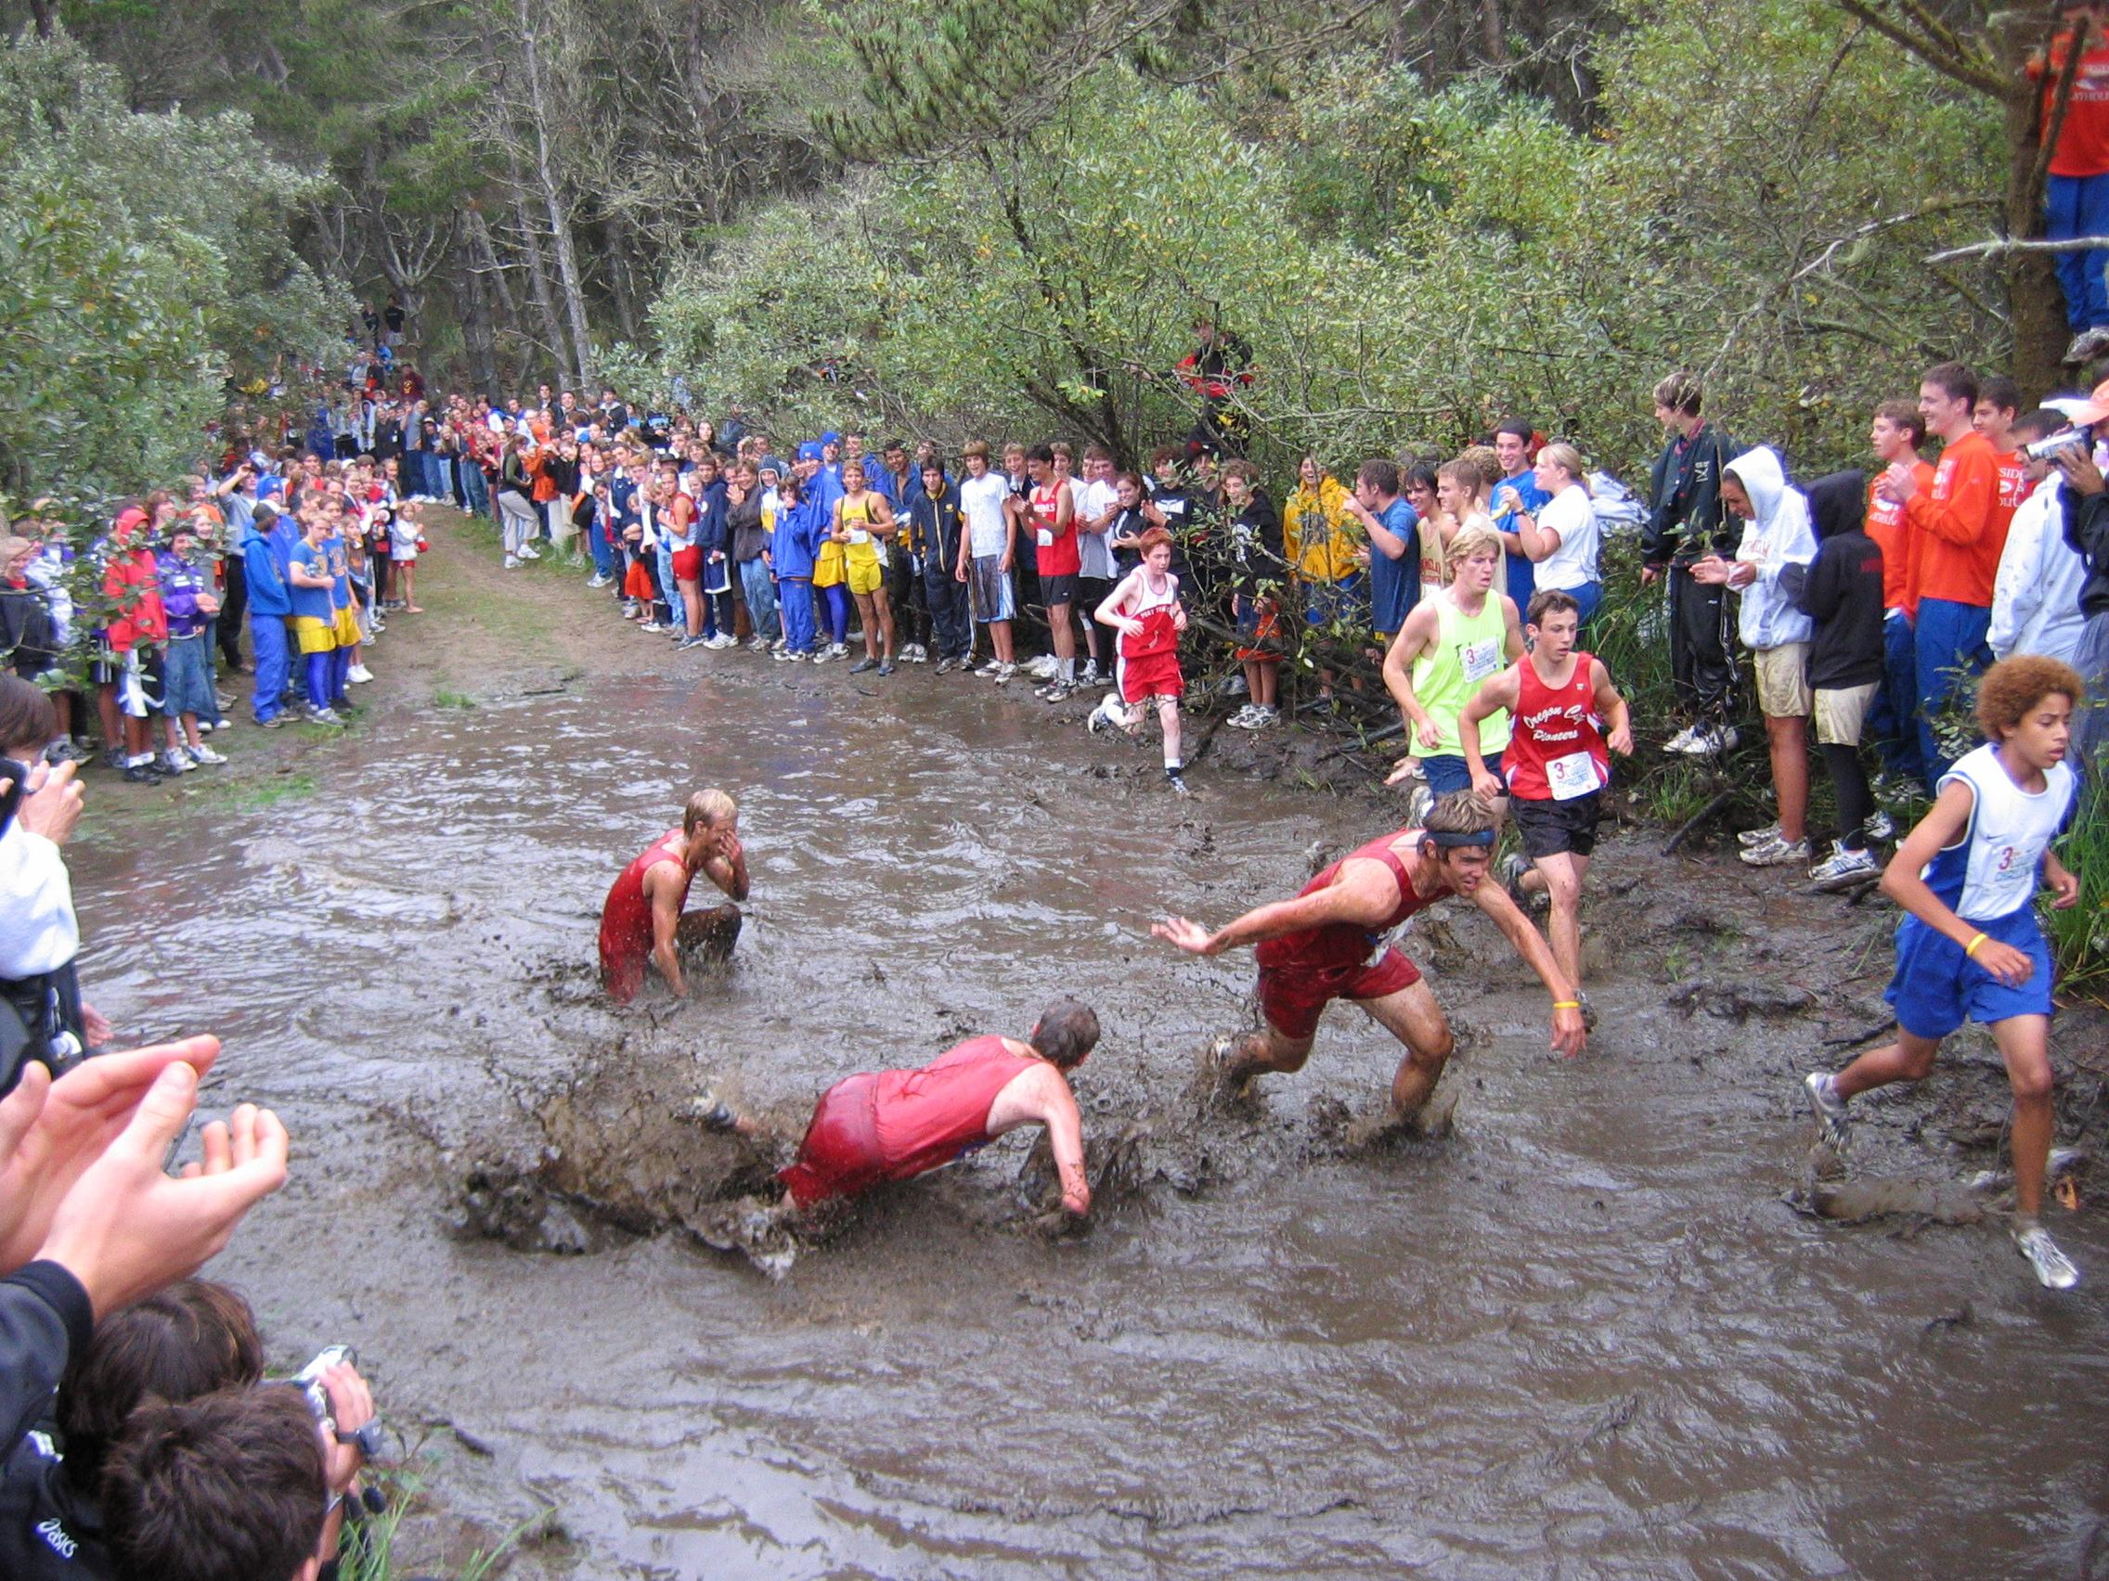
X-Country
Zones for X-Country are held at
Echo Dale Park, Medicine Hat on October 6.
We are in the process of building up this program!!!

Slide 15
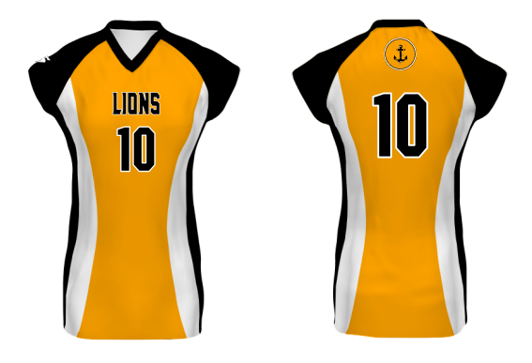
Volleyball
This years teams:
JV Girls
Coached by:
Phil Vriend
Annalise Ypma
JV Boys
Coached by:
Brett McCoy
Jay Visser

Slide 16
Basketball
This year’s teams:
JV/SV Girls
Coaches: TBD
JV Boys
Coached by:
Phil Vriend

Slide 17
Curling
Curling Zones will occur in February.
Practices for curling will start after volleyball season ends.

Slide 18
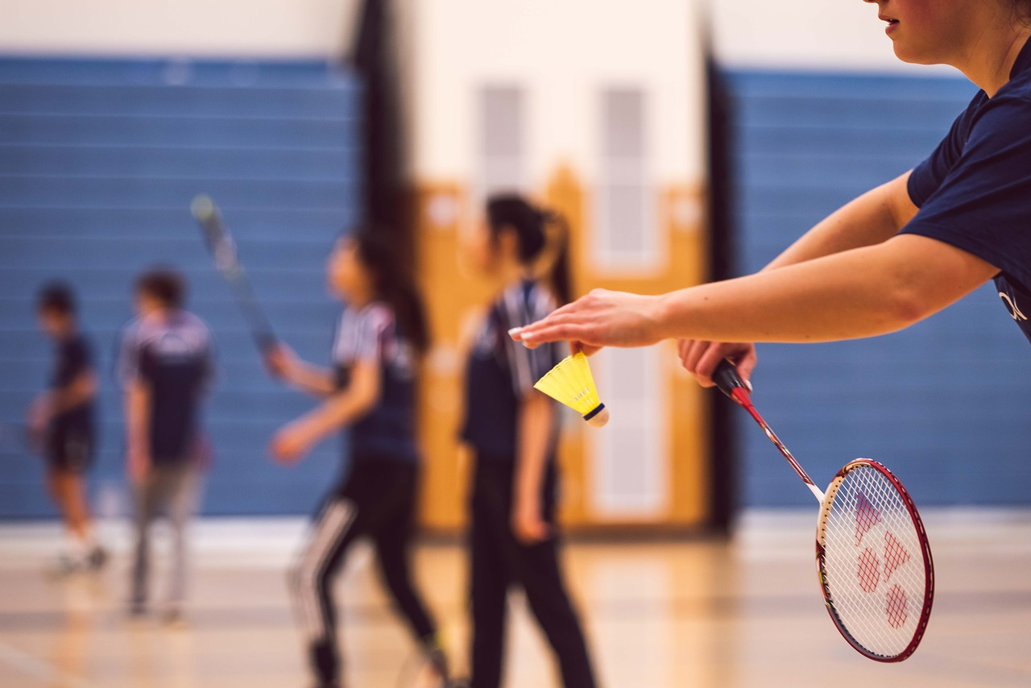
Badminton
Zones for Badminton will occur in Lethbridge on April 29th. Badminton Practices will start up as Basketball season comes to an end.

Slide 19
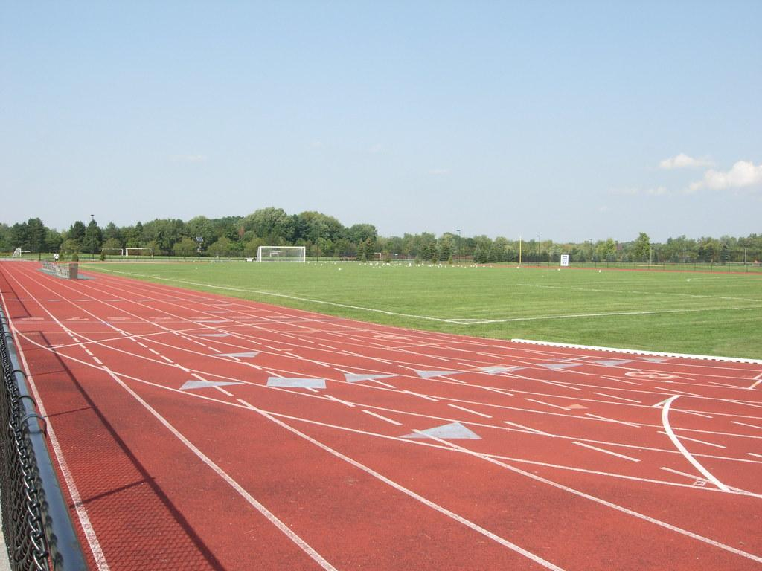
Track and Field
Track and Field Zones will occur on May 26th at Medicine Hat Rotary Track.

Slide 20
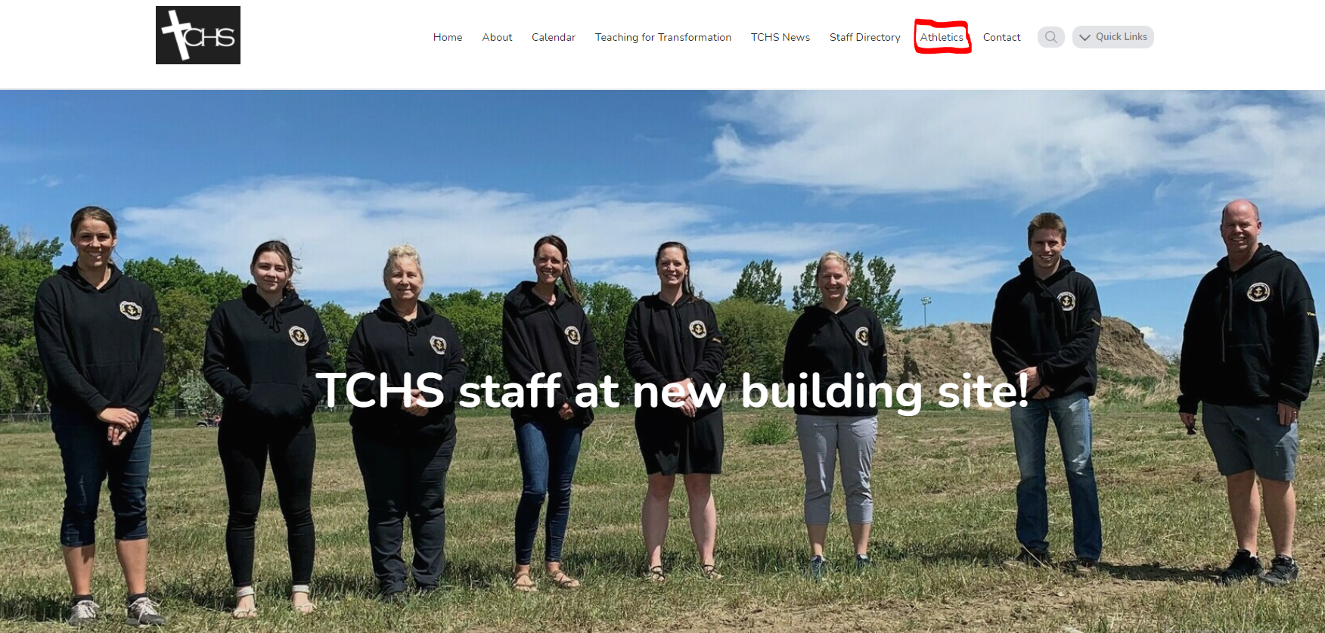
Visit our website to stay informed

Slide 21
Safety Measures that we undertake
Coaches in High School are required to complete the “Making Headway” course in order to be able to coach teams
- Through this coaches learn the proper protocol to follow in the case of a head injury or concussion
- We also have an Emergency Action Plan put in place for any athletic events that we have or are a part of

Slide 22
What is a concussion?
A concussion is a type of traumatic brain injury caused by a bump, blow, or jolt to the head or by a hit to the body that causes the head and brain to move rapidly back and forth.
Signs and Symptoms:
Loss of consciousness
Headache or “pressure” in head.
Nausea or vomiting.
Balance problems or dizziness, or double or blurry vision.
Bothered by light or noise.
Feeling sluggish, hazy, foggy, or groggy.
Confusion, or concentration or memory problems.
Just not “feeling right,” or “feeling down”.
If a person loses consciousness, even for a brief moment, we are required to call 911.

Slide 23
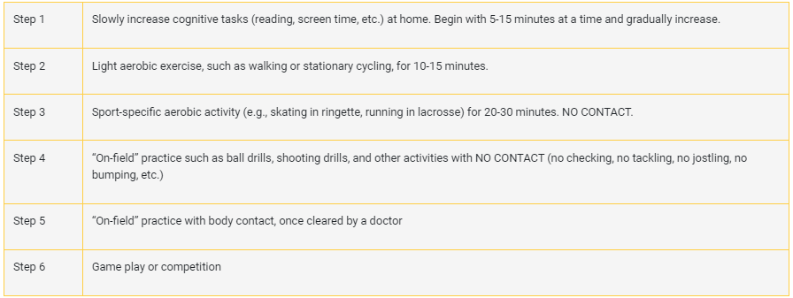
Return to play protocol (after initial clearance with doctor)

Slide 24
Emergency Action Plan
For events hosted by Taber Christian High School:
The emergency action plan is designed for the safety of all participants and spectators of athletic competition.
1. The ‘Take Charge’ Person: This individual will take charge of the situation regarding any immediate medical emergency. The ‘take charge’ person must remain on-site and be aware of the Emergency Action Plan procedure. The “take charge” person will follow this order unless otherwise established:
a) Athletic Director
b) Principal
c) Vice-Principal
d) Teaching Staff Member
2. Procedure: If a student or athlete is critically injured immediate medical attention is required:
a) Remain calm and establish who is in charge of the situation.
b) Call 911 (ref or another adult present)
c) Begin First Aid, and if not certified, send a person to find someone who is
d) Get someone to wait outside the front doors of the school to flag down the ambulance personnel
e) Call the athlete’s parents.
f) Establish a person/people who is in charge of crowd control
(a) In the building
(b) And in the parking lot

Slide 25
Volunteer Requirements
In order Taber Christian High School athletic program to flourish, athletes and parents are required to help volunteer at games, tournaments, athletic fundraisers, and other athletic events.
1. Volleyball
a. Athletes are required to volunteer a minimum of 4 hours
b. Parents are required to volunteer a minimum of 4 hours
2. Basketball
a. Athletes are required to volunteer a minimum of 6 hours
b. Parents are required volunteer a minimum of 6 hours
3. Badminton
a. Athletes are required to volunteer a minimum of 2 hours
b. Parents are required to volunteer a minimum of 2 hours

Slide 26
Transportation to Athletic Events
As per the insurance policy of the Horizon School Division, it is the responsibility of Taber Christian High School to arrange for student transportation to and from athletic events.
Volunteer drivers will be the primary method in which athletes travel to and from athletic events. All volunteer drivers must:
a. Complete and submit the ‘Horizon School Division Volunteer Automobile and/or Driver Authorization Form’ to the school’s office.
b. Obtain a Driver’s Abstract and submit this to school’s office.
Bussing will be used as a secondary method to transport athletes to and from athletic events, or when deemed as the most suitable method of transportation for travel.
Parents may exempt students from the arranged school transportation to athletic events by completing the ‘Horizon School Division Parent/Guardian Responsibility of Student Transportation for School Sponsored Events’ form.

Slide 27
Questions

